Slide 1
SOEN 384
Management, Measurement and Quality Control http://users.encs.concordia.ca/~s384_2/
Instructor: Dr. Olga Ormandjieva
Lecture 16:
Management Key Area 2: Project Planning, Activities Scheduling
Lecture 16 reading material (provided by Dr. Constantinides)

Slide 2
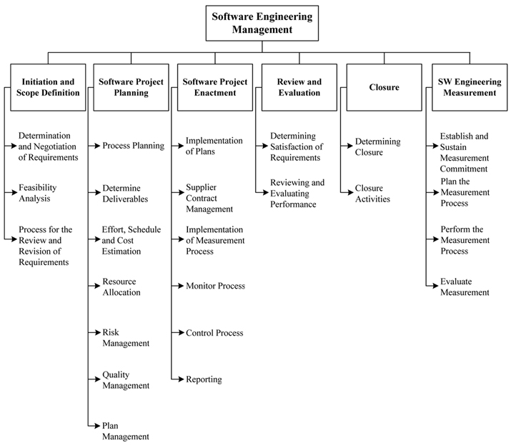
BREAKDOWN OF TOPICS FOR SOFTWARE ENGINEERING MANAGEMENT: SWEBOK
SOEN384-L16: Schedule

Slide 3
Agenda
SEM – KA 2: 2.3. Effort, Schedule, and Cost Estimation
  Process Planning. WBS
  Schedule development
Resource Allocation
Next?
SOEN384-L16: Schedule

Slide 4
Software Scope Definition
(Pressman, Section 31.3.1)
The first software management activity is the determination of software scope:
  Context
  Information Objectives
  Function and performance
A statement of software scope must be bounded
  Testable FRs and NFRs
  Constraints
SOEN384-L16: Schedule

Slide 5
2.1 Process Planning
project's high-level schedule and organization structure:
  Selection of the appropriate software life cycle
  adaptation and deployment of appropriate software life cycle processes
  Decomposition of the project into tasks/activities, with associated inputs, outputs, and completion conditions
    (for example, work breakdown structure)
SOEN384-L16: Schedule

Slide 6
What is WBS? What is the motivation behind it? How to represent it?
WBS is an exhaustive, hierarchical (from general to specific) tree structure of deliverables and tasks that need to be performed to complete a project.
The Project Manager and project team use the WBS to develop the project schedule, resource requirements and costs.
It provides:
  A description of all significant work.
  A clear task decomposition for assignment of responsibilities.
  A framework for scheduling, budgeting, and expenditure tracking.
We can represent it by:
functional responsibilities (decompose features (epics) into use cases (user stories) )
Process activities (user stories decomposed into design, coding, testing, …)
SOEN384-L16: Schedule
Notes:
The Project Manager and project team use the WBS to develop the project schedule, resource requirements and costs.

Slide 7
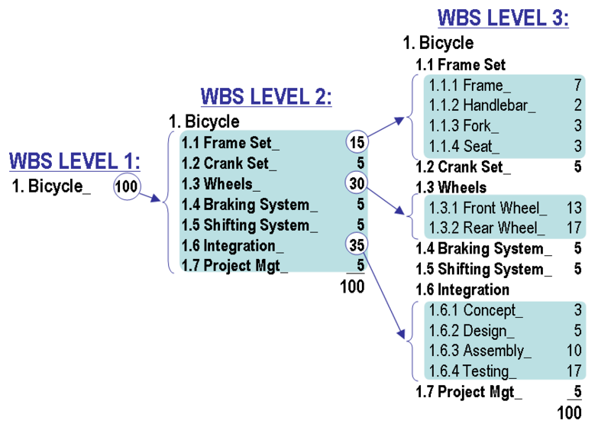
WBS Design principles: Illustration
Mutually exclusive elements
Define WBS elements in terms of outcomes or results
100% rule
SOEN384-L16: Schedule
Notes:
The figure shows a work breakdown structure construction technique that demonstrates the 100% rule and the "progressive elaboration" technique. At WBS Level 1 it shows 100 units of work as the total scope of a project to design and build a custom bicycle. At WBS Level 2, the 100 units are divided into seven elements. The number of units allocated to each element of work can be based on effort or cost; it is not an estimate of task duration.
The three largest elements of WBS Level 2 are further subdivided at Level 3. The two largest elements at Level 3 each represent only 17% of the total scope of the project. These larger elements could be further subdivided using the progressive elaboration technique described above.
WBS design can be supported by software to allow automatic rolling up of point values. Estimates of effort or cost can be developed through discussions among project team members. This collaborative technique builds greater insight into scope definitions, underlying assumptions, and consensus regarding the level of granularity required to manage the project.
http://en.wikipedia.org/wiki/Work_breakdown_structure

Slide 8
Sample WBS high-level structures
Features
Feature 1
Feature 2
Feature 3
...
User stories
User story 1
User story 2
User story 3
...
Process Activities
Requirements
Design
Coding
….
SOEN384-L16: Schedule

Slide 9
Sample planning based on WBS high-level structure
Features | Actual Effort | Estimated effort | Priority (based on business value, risk assessment, ...) | Iteration#
Feature 1
Feature 2
Feature 3
...
scope
SOEN384-L16: Schedule

Slide 10
Sample planning based on WBS high-level structure: Example
Feature | Developer 1 | Developer 2 | Developer 3 | Developer 4
verify PIN
shortest (person-hours) | 2 | 3 | 2.5 | 4
longest (person-hours) | 8 | 7 | 9 | 5
likely (person-hours) | 5 | 4 | 4.5 | 7
PERT= | 5 | 4.3 | 4.9 | 6.16
Estimated effort = Average | 5
SOEN384-L16: Schedule

Slide 11
Granularity
One of the best ways to improve the accuracy of task-level estimates is to separate large tasks into smaller tasks.
soen384-F15-L10: Scope

Slide 12
Sample detailed WBS
Features | tasks
Feature 1 | Feature 1 tasks
 | Management
 | Requirements
 | Design
 | Implementation
 | Quality Control
Feature 2 | Feature 2 tasks
...
SOEN384-L16: Schedule

Slide 13
Sample (soen390)
Use the Feature Estimated Effort to calculate individual task effort:
Task Effort =
Feature Estimated Effort * Average task% from previous projects
Average task% from previous projects
Features | tasks | Actual Effort | Estimated effort
Feature 1 | Feature 1 tasks |  | Effort_F1
 | Management |  | Effort_F1*10%
 | Requirements |  | Effort_F1*15%
 | Design |  | Effort_F1*15%
 | Implementation |  | Effort_F1*40%
 | Quality Control |  | Effort_F1*20%
Feature 2 | Feature 2 tasks |  | Effort_F2
...
soen384-F15-L10: Scope

Slide 14
SEM – KA 2: 2.3. Effort, Schedule, and Cost Estimation
Based on the breakdown of activities (Work Breakdown Structure)
expected effort required for each activity
  determined using a calibrated estimation model based on historical size-effort data where available and relevant, or
  other methods like expert judgment.
SOEN384-L16: Schedule

Slide 15
When to estimate effort for software project planning?
once the scope is determined, it is essential to estimate the effort & cost of the proposed developments (or candidate solutions), and therefore the feasibility.
SOEN384-L16: Schedule

Slide 16
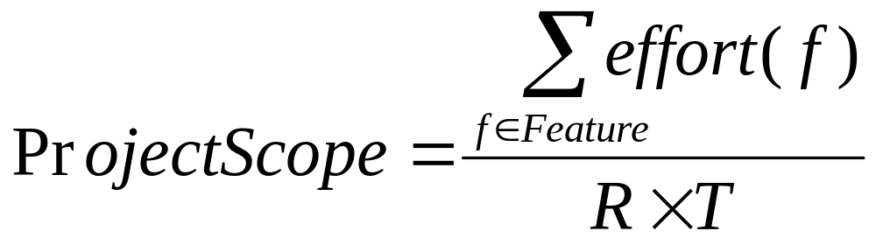
Resources (R)
Scope
Boundary
Time (T)
Feature
SOEN384-L16: Schedule

Slide 17
Why Effort & Cost Estimation?
Estimating how many features you can deliver within a specific development iteration
Planning new development work (schedule, effort, cost, people)
Estimating number of developers
…
SOEN384-L16: Schedule

Slide 18
How to use effort in planning? Examples
Example1: A person working full time in a small program for 1 day:
    Duration of the activity = 1 workday*
    Effort = 7 person-hours
Example 2: Five persons working full time for six weeks in a project, 35 hours of work per week.
    Duration = 6 weeks
    Effort = (5 persons * 6 weeks * 35 hours/week) = 1,050 person-hours
Example 3: Estimated effort is 250 person-hours, 4 developers, 5h per week per person, duration: 12 weeks. Is it feasible?
    4x5hx12weeks=240 person-hours
    240person-hours < 250 person-hours => No
SOEN384-L16: Schedule

Slide 19
Agenda
SEM – KA 2: 2.3. Effort, Schedule, and Cost Estimation
  Process Planning. WBS
  Schedule development
Resource Allocation
Next?
SOEN384-L16: Schedule

Slide 20
Project Schedule
Scheduling: activity that distributes estimated effort across the planned project duration by allocating the effort to specific software engineering tasks.
SOEN384-L16: Schedule
Notes:
Task set: a collection of software engineering work tasks, milestones, and deliverables that muat be accomplished to complete a particular project.
Evolves over time from a macroscopic schedule refined into a detailed schedule

Slide 21
Schedule development principles
Each task must be allocated some number of work units (e.g. person-hours of effort).
Following this, we need to determine the interdependency of each (compartmentalized) task.
  Some tasks must work in sequence, while some others may work in parallel. Certain tasks may work independently.
Finally, each task must be assigned a start-date and a completion-date.
SOEN384-L16: Schedule

Slide 22
Tools and Techniques for Schedule Development
The most widely known mathematical analysis techniques are:
Critical Path Method (CPM)—calculates a single, deterministic early and late start and finish date for each activity based on specified, sequential network logic and a single duration estimate.
    The focus of CPM is calculating float to determine which activities have the least scheduling flexibility
Output: expected schedule of tasks with projected start times, durations, and end times is produced
SOEN384-L16: Schedule
Notes:
.

Slide 23
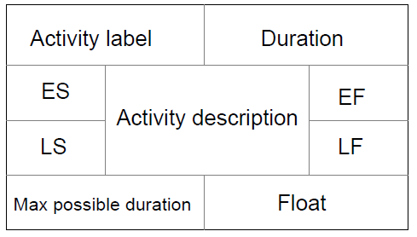
Activity-on-node networks
An activity-on-node network is a directed mathematical graph nodes represent activities.
A node includes certain information about an activity, such as earliest and latest times. Edges represent transitions from one activity to another
Example in class
SOEN384-L16: Schedule

Slide 24
Time parameters
Earliest start time (ES): the earliest time at which the activity can start given that its precedent activities must be completed first.
Earliest finish time (EF) equals to the earliest start time for the activity plus the time required to complete the activity.
Latest finish time (LF): the latest time at which the activity can be completed without delaying the project.
Latest start time (LS) equals to the latest finish time minus the time required to complete the activity.
SOEN384-L16: Schedule

Slide 25
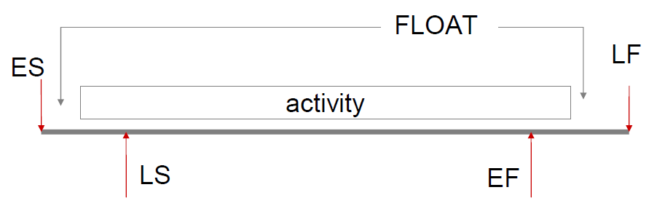
Determining the activity floats
Float = LF − Duration − ES
SOEN384-L16: Schedule
Notes:
In essence, float is a measure of how much the start or
completion of an activity may be delayed without affecting the
end date of the project. Any activity with zero float is critical
as any delay will affect the completion of the entire project.

Slide 26
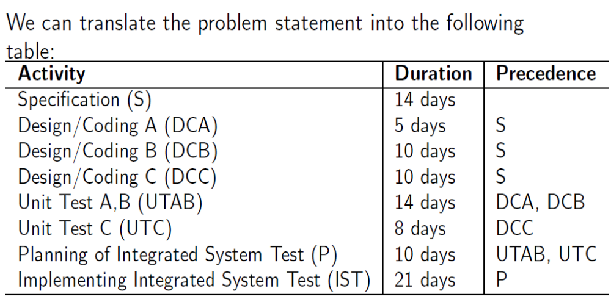
Example in class:
SOEN384-L16: Schedule

Slide 27
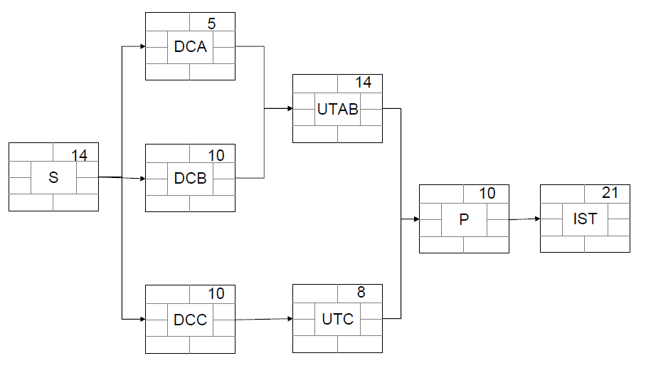
Example in class: Translating the table into a graph
SOEN384-L16: Schedule

Slide 28
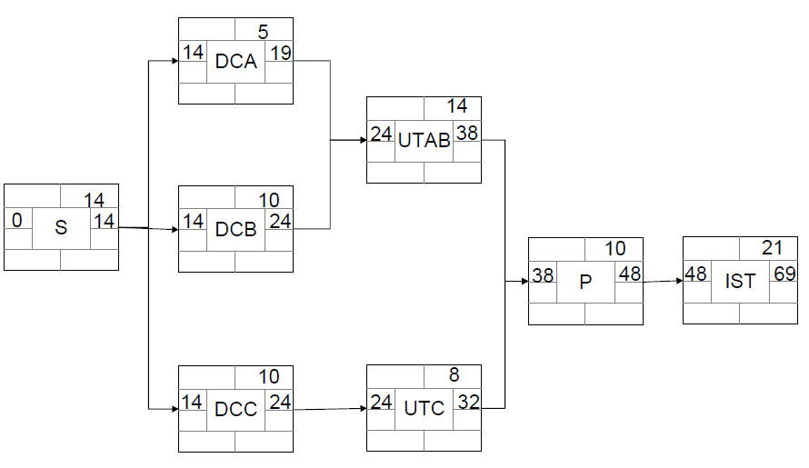
Determining the earliest times
The forward pass rule: The earliest start date for the
current activity is the earliest finish date for the previous.
When there is more than one previous activity, we take the
latest between all previous activities.
SOEN384-L16: Schedule

Slide 29
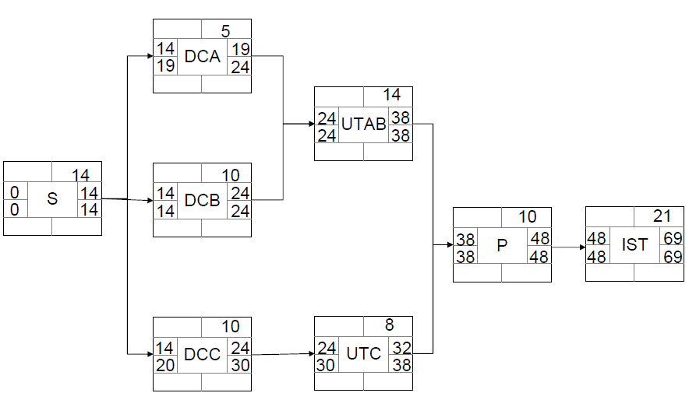
Determining the latest times
The backwards pass rule: Start from the last activity: The latest finish (LF) for the last activity is the same as the earliest finish (EF) of that activity.
LF (activity) = LS (following activity)
LF(activity) = min (LSs of following activities).
LS(activity) = LF(activity) - duration(activity).
SOEN384-L16: Schedule
Notes:
We assume that the latest finish date for the project is the
same as the earliest finish date, i.e. we wish to complete the
project as early as possible.

Slide 30
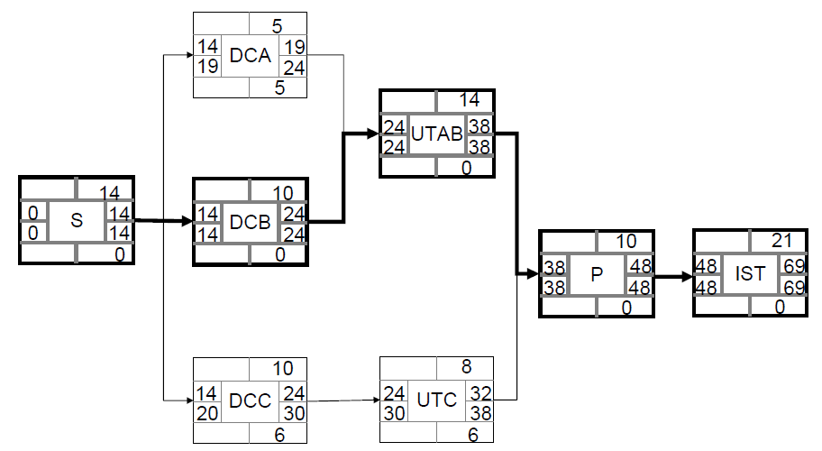
Determining the critical paths
The critical path determines the total calendar time required for the project.
If activities outside the critical path speed up or slow down (within limits), the total project time does not change.
SOEN384-L16: Schedule

Slide 31
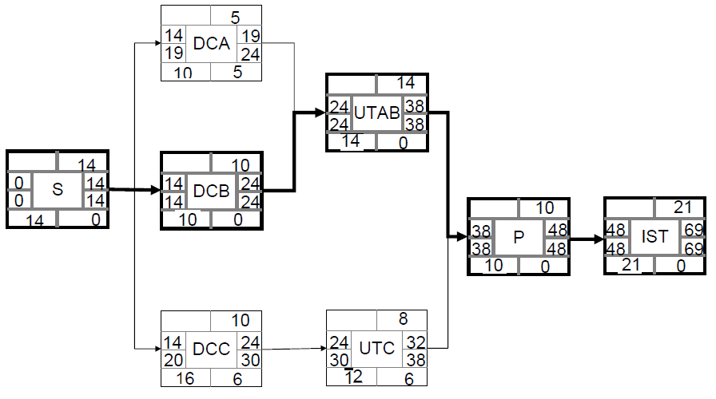
Maximum possible duration
The maximum possible duration is given by LF − ES.
SOEN384-L16: Schedule

Slide 32
Critical Paths Key Points http://www.mindtools.com/critpath.html
Drawing a Critical Path Method Chart
Step 1. List all activities in the plan
Step 2. Plot the activities as a circle and arrow network diagram
Identify the “critical path”
  (activities which must be very closely managed to ensure that they are completed on time)
SOEN384-L16: Schedule
Notes:
As with Gantt Charts, Critical Path Analysis method helps you to plan all tasks that must be completed as part of a project. They act as the basis both for preparation of a schedule, and of resource planning. During management of a project, they allow you to monitor achievement of project goals.
A further benefit of Critical Path Analysis is that it helps you to identify the minimum length of time needed to complete a project. Where you need to run an accelerated project, it helps you to identify which project steps you should accelerate to complete the project within the available time.
If jobs on the critical path slip, immediate action should be taken to get the project back on schedule. Otherwise completion of the whole project will slip.
The tools make modification of plans easier and provide facilities for monitoring progress against plans.

Slide 33
Agenda
Process Planning. WBS
Schedule development
Resource Allocation
Next?
SOEN384-L16: Schedule

Slide 34
Schedule and
Resource allocation
Every scheduled task must be assigned to a specific team member and it should have a defined outcome.
The project manager must ensure that the appropriate number of people have been scheduled at any given time.
  Example: consider three assigned engineers (i.e. three person-days are available per day of assigned effort) for seven parallel tasks to be accomplished, on some given day, each requiring 0.5 person-days of effort.
  in class
SOEN384-L16: Schedule

Slide 35
Key Objectives of activity scheduling
Feasibility assessment: Is the project possible within the required resource constraints?
  Example: if the project requires 12 months with 5 people, can it be done in 6 months with twice as many people?
Allocation of resources
  What are the most effective ways of allocating resources to the project? When should resources be available?
Detailed costing (per feature, activity)
SOEN384-L16: Schedule

Slide 36
Next?
Management Key Area 3: Project Monitoring & Control
SOEN384-L16: Schedule

Slide 37

Questions?
SOEN384-L16: Schedule

